Slide 1
Physics 3 – Oct 15, 2019
Do Now: Complete the Peer Evaluations sheets for your Mini IA project. Hand in Reports. (60 pts = 30 pts for completion on time ( -1 per day late), 24 pts via rubric, 6 pts peer review)
P3 Challenge –
Sketch the graphs of potential energy and kinetic energy versus position for the simple harmonic motion of a mass on a horizontal spring.

Slide 2
Objectives/Agenda/Assignment
Objective:
  4.2 Traveling Waves Introduction
Agenda:
  Fun with Springs activity
  Observe different types of waves qualitatively and quantitatively.
  Introduction to waves

Slide 3
4.2 Travelling Waves - Objectives
Describe waves and wave motion
Identify wavelength, frequency, and period from graphs of displacement against distance or time
Solve problems with wavelength, frequency, period and wave speed.
Describe the motion of a particle in a medium through which a wave travels
Classify waves as transverse and longitudinal
Describe the nature of electromagnetic waves
Describe the nature of sound waves

Slide 4
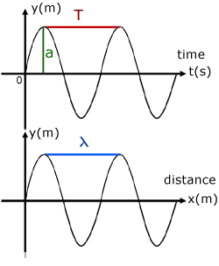
Describing waves
The displacement from equilibrium of any particle in the medium is dependent on both time and distance.
The top graph “y vs t” is how a single location in the medium moves over time. Distance is held constant.
  Stationary bystander perspective.
The bottom graph “y vs x” is how different parts of the medium are displaced at a given point in time. Time is held constant.
  Snapshot moment in time.
Amplitude of a wave, : The amount of displacement from the equilibrium position for a given particle in the medium.

Slide 5
Describing waves
Period of a wave, T, seconds: The length of time required for a complete waveform to pass a fixed point.
  The peak to peak, trough to trough, or wave beginning to end interval on the y vs t graph.
  Bystander with stopwatch
Wavelength, λ, meter: The length of one complete waveform at a fixed point in time.
  The peak to peak, trough to trough, or wave beginning to end interval on the y vs x graph.
  Tiny rider of wave sight line to next peak

Slide 6
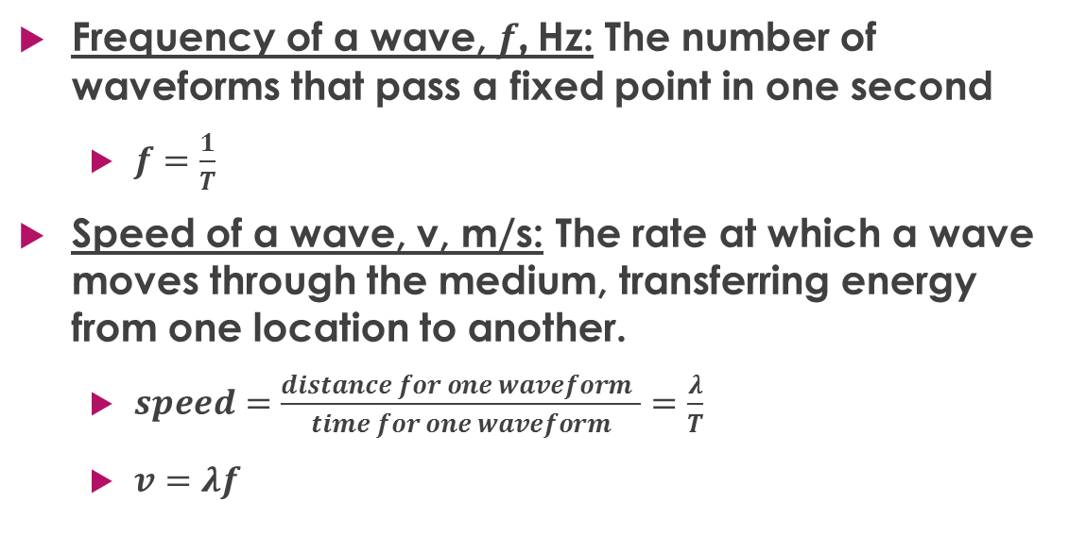
Describing waves
Frequency of a wave, $f$, Hz: The number of waveforms that pass a fixed point in one second
  $f=\frac{1}{T}$
Speed of a wave, v, m/s: The rate at which a wave moves through the medium, transferring energy from one location to another.
  $speed=\frac{distance for one waveform }{time for one waveform}=\frac{λ}{T}$
  $v=λf$

Slide 7
Longitudinal waves
Previous waves were all transverse waves with the motion of the wave is perpendicular to the displacement.
The displacement for a longitudinal wave (e.g. sound) is in the same direction as the motion of the wave.
It is still graphed as a “y” displacement.
The result is an alternating series of zones of compressions and rarefactions.
A wavelength is from start of one compression to the beginning of the next compression.
Positive displacement are compressions. Negative displacements are rarefactions.

Slide 8
Sample problems
A person lying on a boogie board in the ocean rises and falls through one complete cycle every five seconds. The crests of the wave causing the motion are 20.0 m apart. Determine a) the frequency and b) the speed of the wave.
The speed of a transverse wave on a string is 450 m/s and the wavelength is 0.18 m. The amplitude of the wave is 2.0 mm. How much time is required for a particle of the string to move through a total distance of 1.0 km?
A sound wave with a speed of 330 m/s and a frequency of 425 Hz is sounded through air. At what distances from the sound source will you find the first three points of lowest air pressure?

Slide 9
Instances of wave behavior
Three classes of waves
1) Mechanical (physical) waves
  Transverse (Waves on strings, water waves)
  Longitudinal (Sound, waves in a pipe)
2) Electromagnetic Radiation (aka light)
3) Matter waves (e.g. electrons)
4) Gravitational waves (spacetime)

Slide 10
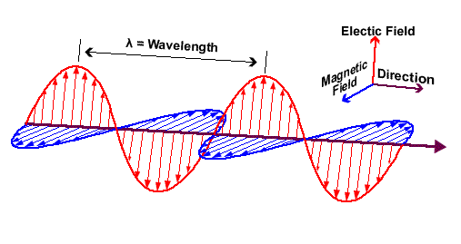
Electromagnetic radiation
Doesn’t need a medium for transmission. All mechanical waves do.
  The reason why EMR is a different class of wave
Perpendicular oscillation of electric and magnetic fields. (Must have both.)
Direction of the wave (transfer of energy) is perpendicular to both fields.
Wavelength, frequency, period, speed and amplitude all apply

Slide 11
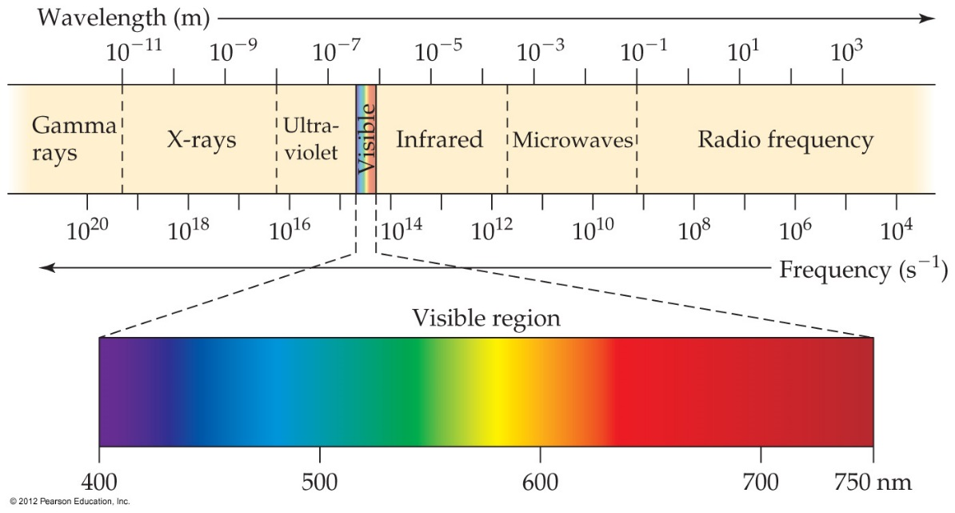

Electromagnetic Radiation
All electromagnetic radiation travels at the same velocity in a vacuum: the speed of light (c), 3.00 × 10⁸ m/s.
Therefore, c = λ$f$
What is the frequency
of EM radiation with
a wavelength of 213μm?
Also, be able to rank the
different types of EMR.
Memorize the order.

Slide 12
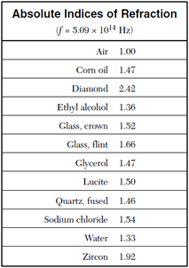
Electromagnetic Radiation
While a medium is not required, EMR can and often does pass through a medium.
EMR passes more slowly through a medium than through a vacuum and travels at a normal velocity v, less than c.
The ration of v/c for a given medium is called the index of refraction, n, for the medium.
Notice air can be approximated as a vacuum, even though it’s not.

Slide 13
Exit slip and homework
  Exit Slip – FM Radio stations are given in MHz. What is the wavelength for 105.7 FM?
  What’s due? (homework for a homework check next class)
    p161 #6 – 9, 10 – 14
  What’s next? (What to read to prepare for the next class.
    Read IB 4.3 - 4.4, p162 – 181

